Slide 1
Notes:
‹#›

Slide 2
The Key Roles of Cell Division
The ability of organisms to produce more of their own kind best distinguishes living things from nonliving matter
The continuity of life is based on the reproduction of cells, or cell division (細胞分裂)

Slide 3
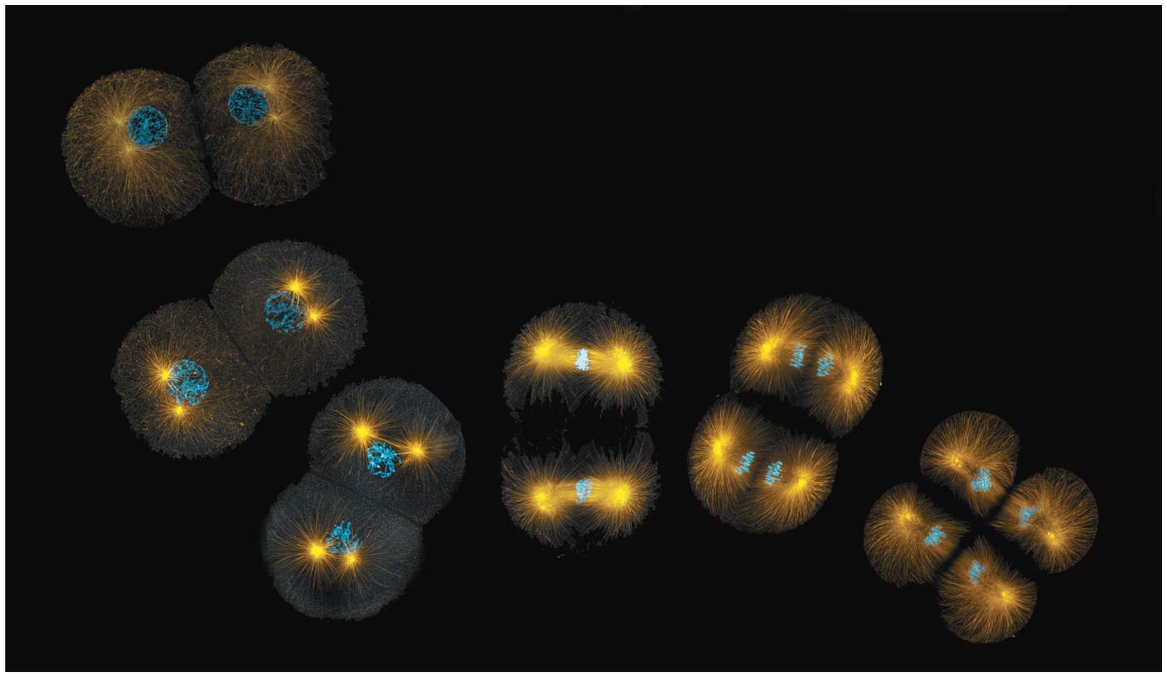
Figure 12.1
How do dividing cells distribute chromosomes to daughter cells?
Notes:
Figure 12.1 How do dividing cells distribute chromosomes to daughter cells?

Slide 4
In unicellular organisms, division of one cell reproduces the entire organism
Multicellular eukaryotes depend on cell division for
development from a fertilized egg
growth
repair
Cell division is an integral part of the cell cycle, the life of a cell from formation to its own division

Slide 5
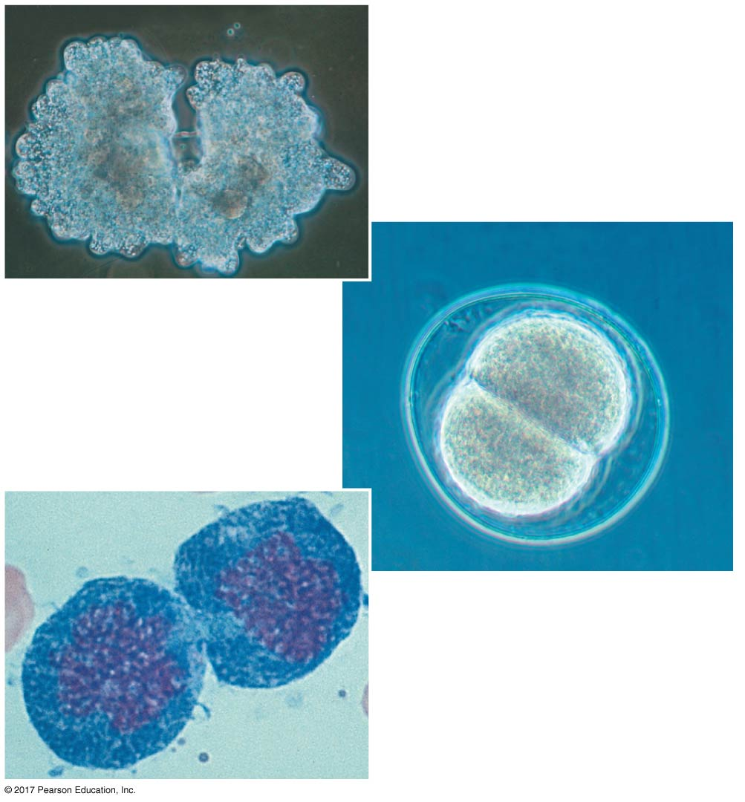
Figure 12.2
100 µm
(a) Asexual reproduction
The functions of cell division
50 µm
(b) Growth and development
(c) Tissue renewal
20 µm
Notes:
Figure 12.2 The functions of cell division

Slide 6
Concept 12.1: Most cell division results in genetically identical daughter cells
Most cell division results in two daughter cells with identical genetic information, DNA
The exception is meiosis (減數分裂), a special type of division that can produce sperm and egg cells

Slide 7
Cellular Organization of the Genetic Material
All the DNA in a cell constitutes the cell’s genome (基因體)
A genome can consist of a single DNA molecule (common in prokaryotic cells) or a number of DNA molecules (common in eukaryotic cells)
DNA molecules in a cell are packaged into chromosomes

Slide 8
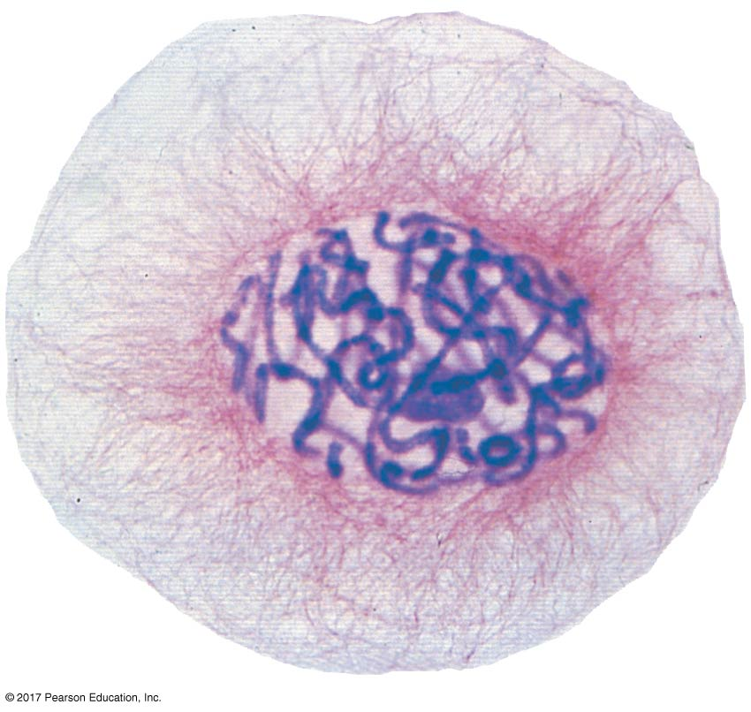
Figure 12.3
Eukaryotic chromosomes
20 µm
Notes:
Figure 12.3 Eukaryotic chromosomes

Slide 9
Eukaryotic chromosomes consist of chromatin (染色質), a complex of DNA and protein that condenses during cell division
Every eukaryotic species has a characteristic number of chromosomes in each cell nucleus
Somatic cells (體細胞)(nonreproductive cells) have two sets of chromosomes
Gametes (配子)(reproductive cells: sperm and eggs) have half as many chromosomes as somatic cells

Slide 10
Distribution of Chromosomes During Eukaryotic Cell Division
In preparation for cell division, DNA is replicated and the chromosomes condense
Each duplicated chromosome has two sister chromatids (姐妹染色單體)(joined copies of the original chromosome), attached along their lengths by cohesins
The centromere(著絲點)is the narrow “waist” of the duplicated chromosome, where the two chromatids are most closely attached

Slide 11
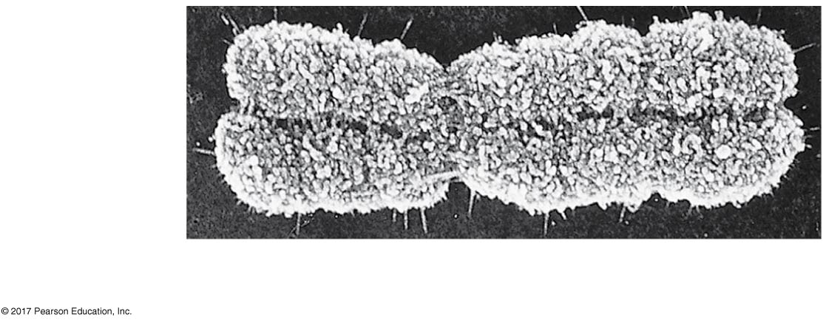
Figure 12.4
A highly condensed, duplicated human chromosome (SEM)
Sister
chromatids
Centromeres, one on
each sister chromatid
0.5 µm
Notes:
Figure 12.4 A highly condensed, duplicated human chromosome (SEM)

Slide 12
During cell division, the two sister chromatids of each duplicated chromosome separate and move into two nuclei
Once separate, the chromatids are called chromosomes

Slide 13
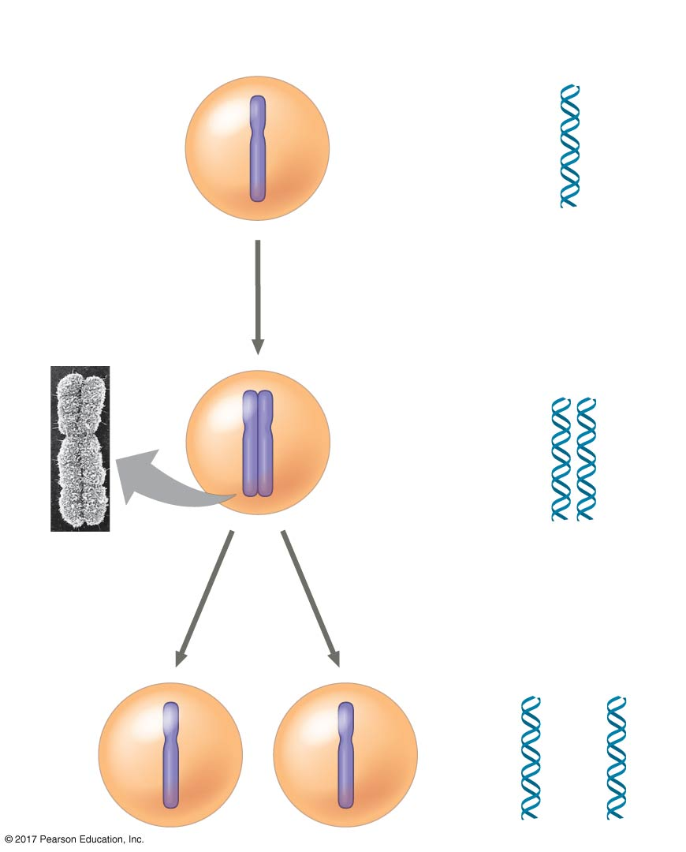
Figure 12.5_3
1
Chromosomes
Chromosomal
DNA molecules
Chromosome duplication and distribution during cell division
Centromere
Chromosome
arm
Chromosome duplication
2
Sister
chromatids
Separation of sister
chromatids
3
Notes:
Figure 12.5_3 Chromosome duplication and distribution during cell division (step 3)

Slide 14
Eukaryotic cell division consists of
Mitosis (有絲分裂), the division of the genetic material in the nucleus
Cytokinesis (細胞分裂), the division of the cytoplasm
Gametes are produced by a variation of cell division called meiosis (減數分裂)
Meiosis yields nonidentical daughter cells that have half as many chromosomes as the parent cell

Slide 15
Concept 12.2: The mitotic phase alternates with interphase in the cell cycle
In 1882, the German anatomist Walther Flemming developed dyes to observe chromosomes during mitosis and cytokinesis

Slide 16
Phases of the Cell Cycle
The cell cycle consists of
mitotic (M) phase (mitosis and cytokinesis)
interphase (間期)(cell growth and copying of chromosomes in preparation for cell division)

Slide 17
Interphase (about 90% of the cell cycle) can be divided into three phases:
G₁ phase (“first gap”)
S phase (“synthesis”)
G₂ phase (“second gap”)
The cell grows during all three phases, but chromosomes are duplicated only during the S phase

Slide 18
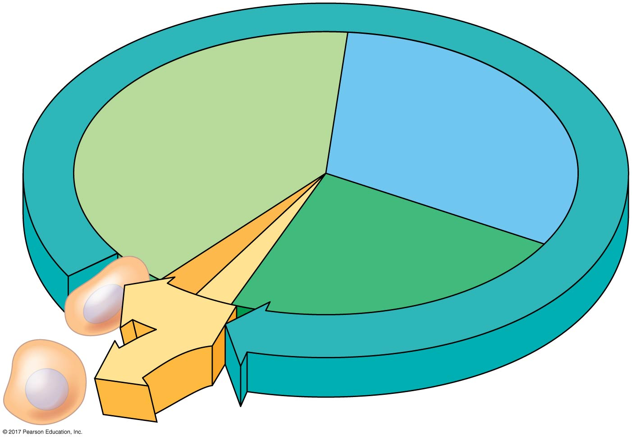

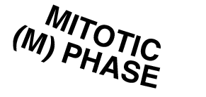
Figure 12.6
The cell cycle
S
G₁
(DNA synthesis)
Cytokinesis
G₂
Mitosis
Notes:
Figure 12.6 The cell cycle

Slide 19
Mitosis is conventionally broken down into five stages:
prophase前期
Prometaphase前中期
metaphase中期
Anaphase後期
Telophase末期

Slide 20
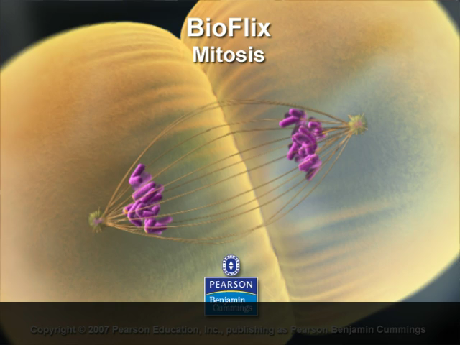
BioFlix Animation: Mitosis

Slide 21
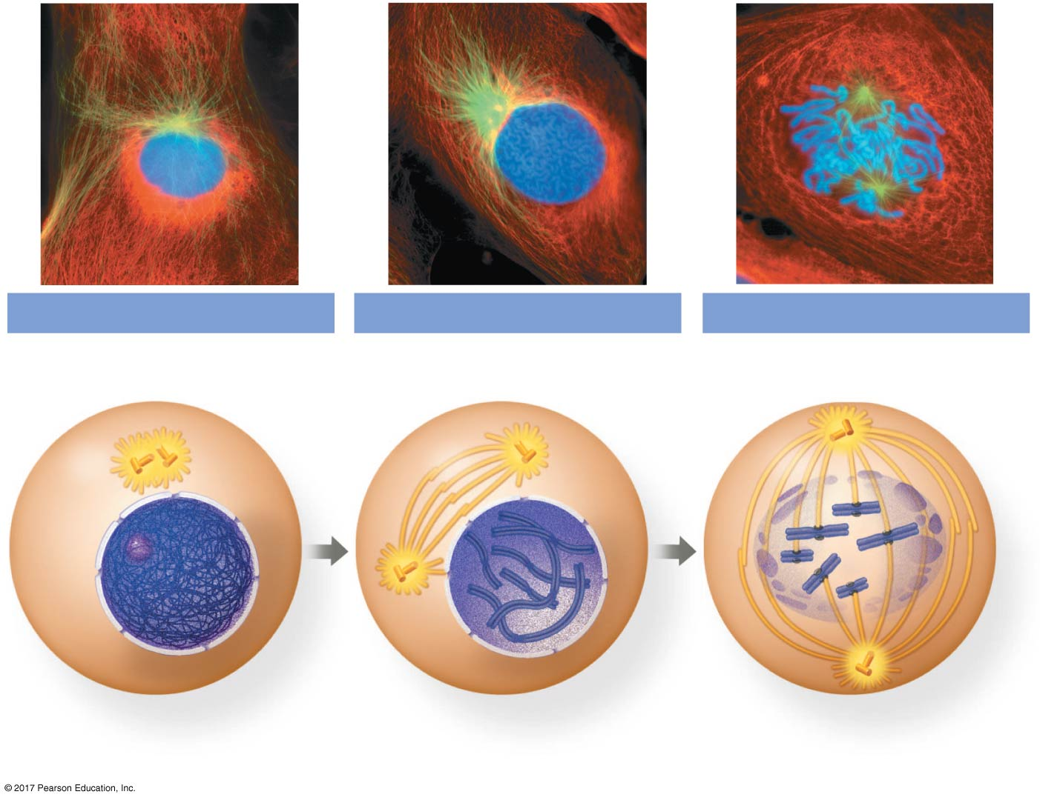
Figure 12.7a
10 µm
G₂ of Interphase
Prophase
Prometaphase
Centrosomes
(with centriole
pairs)
Chromosomes
(duplicated,
uncondensed)
Early mitotic
spindle
Fragments
of nuclear
envelope
Nonkinetochore
microtubules
Aster
Centromere
Nucleolus
Plasma
membrane
Two sister chromatids
of one chromosome
Kinetochore
Kinetochore
microtubules
Nuclear
envelope
Notes:
Figure 12.7a Exploring mitosis in an animal cell (part 1: G₂ of interphase through prometaphase)

Slide 22
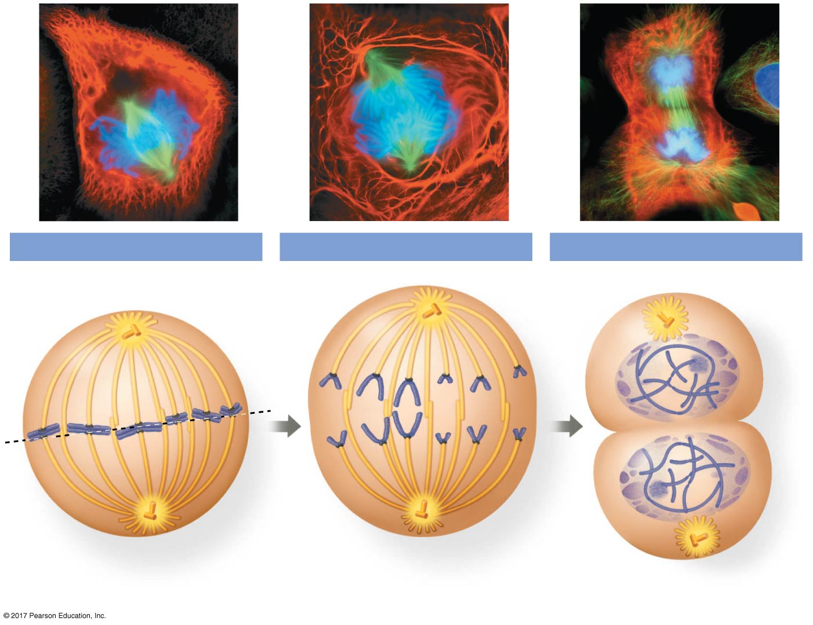
Figure 12.7b
10 µm
Metaphase
Anaphase
Telophase and Cytokinesis
Metaphase
plate
Cleavage
furrow
Nucleolus
forming
Daughter
chromosomes
Spindle
Nuclear
envelope
forming
Centrosome at
one spindle pole
Notes:
Figure 12.7b Exploring mitosis in an animal cell (part 2: metaphase through cytokinesis)

Slide 23
The Mitotic Spindle: A Closer Look
The mitotic spindle (有絲分裂紡錘體)is a structure made of microtubules that controls chromosome movement during mitosis
In animal cells, assembly of spindle microtubules begins in the centrosome(中心體), the microtubule-organizing center
The centrosome replicates during interphase, forming two centrosomes that migrate to opposite ends of the cell during prophase and prometaphase

Slide 24
An aster(星狀體) (a radial array of short microtubules) extends from each centrosome
The spindle includes the centrosomes, the spindle microtubules, and the asters

Slide 25
During prometaphase, some spindle microtubules attach to the kinetochores (著絲點)of chromosomes and begin to move the chromosomes
Kinetochores are protein complexes associated with centromeres
At metaphase, the chromosomes are all lined up at the metaphase plate, a plane midway between the spindle’s two poles

Slide 26
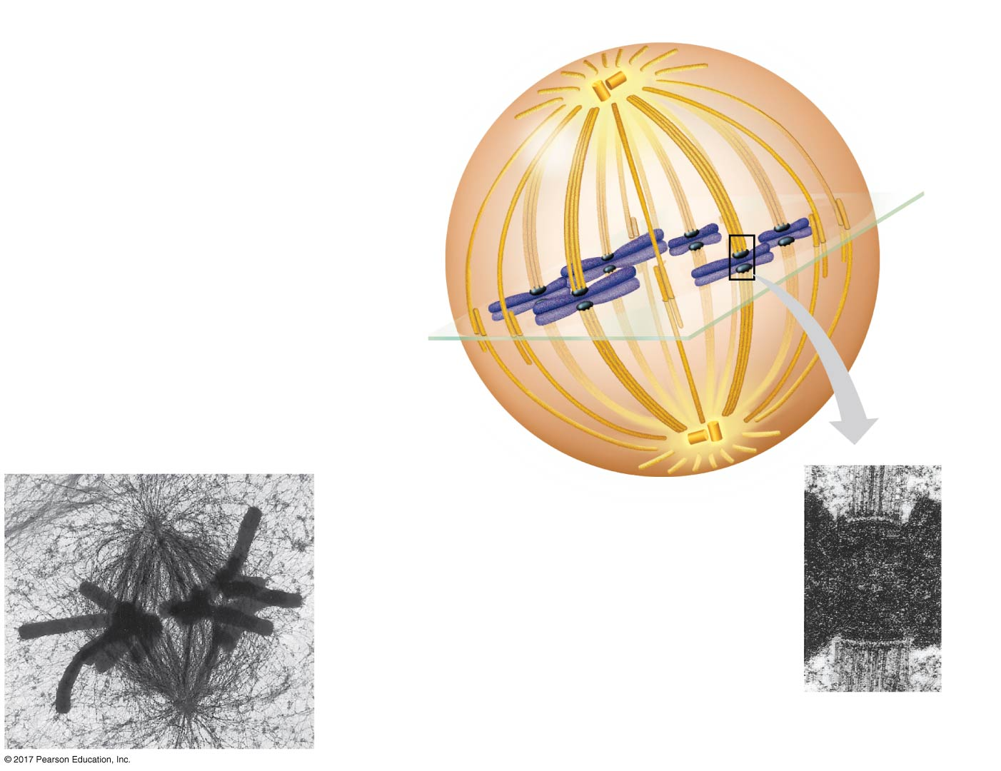
Figure 12.8
Aster
Centrosome
Sister
chromatids
Metaphase
plate
(imaginary)
The mitotic spindle at metaphase
Kineto-
chores
Microtubules
Overlapping
nonkinetochore
microtubules
Kinetochore
microtubules
Chromosomes
Centrosome
1 µm
0.5 µm
Notes:
Figure 12.8 The mitotic spindle at metaphase

Slide 27
In anaphase the cohesins(黏合素)are cleaved by an enzyme called separase
Sister chromatids (染色單體) separate and move along the kinetochore microtubules toward opposite ends of the cell
The microtubules shorten by depolymerizing at their kinetochore ends

Slide 28
Results of a clever experiment suggest that motor proteins on kinetochores “walk” the chromosomes along the microtubules during anaphase
The depolymerization of the microtubules at the kinetochore ends occurs after the motor proteins have passed
This is called the “Pac-man” mechanism

Slide 29
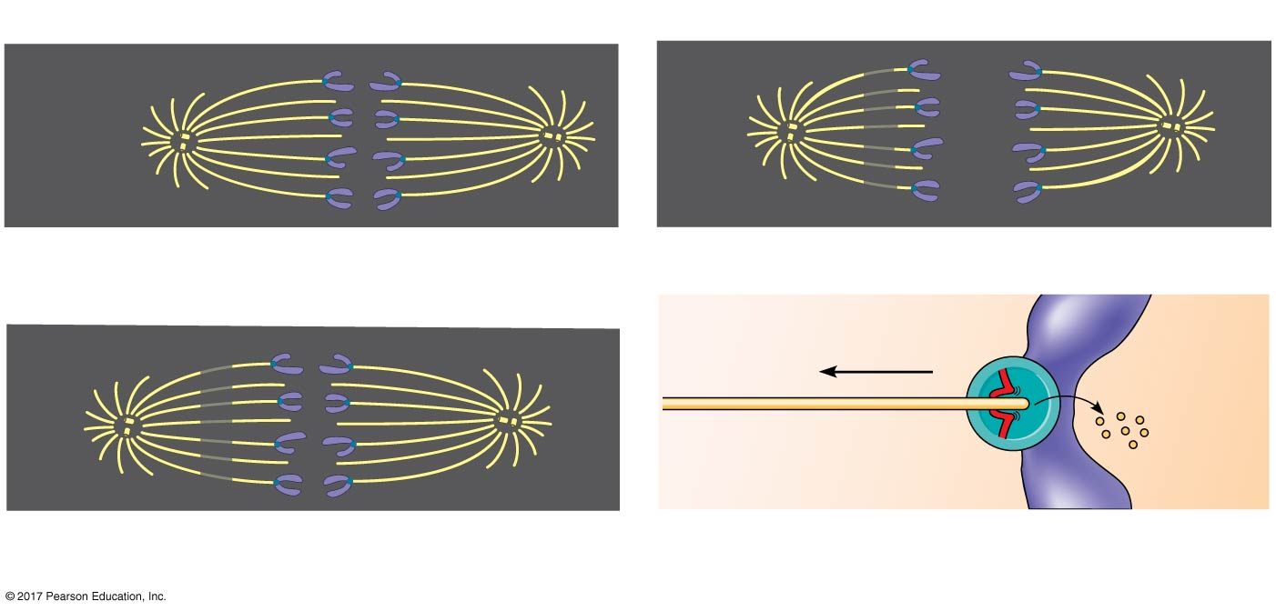
Figure 12.9
At which end do kinetochore microtubules shorten during anaphase?
Experiment
Results
Kinetochore
Spindle
pole
Conclusion
Chromosome
movement
Mark
Kinetochore
Microtubule
Motor
protein
Tubulin
subunits
Chromosome
Data from G. J. Gorbsky, P. J. Sammak, and G. G. Borisy, Chromosomes move poleward in anaphase along stationary microtubules that coordinately
disassemble from their kinetochore ends, Journal of Cell Biology 104:9–18 (1987).
Notes:
Figure 12.9 Inquiry: At which end do kinetochore microtubules shorten during anaphase?

Slide 30
Nonkinetochore microtubules from opposite poles overlap and push against each other, elongating the cell
At the end of anaphase, duplicate groups of chromosomes have arrived at opposite ends of the elongated cell
Cytokinesis begins during anaphase or telophase, and the spindle eventually disassembles

Slide 31
Cytokinesis: A Closer Look
In animal cells, cytokinesis occurs by a process known as cleavage, forming a cleavage furrow
In plant cells, a cell plate (細胞板) forms during cytokinesis

Slide 32
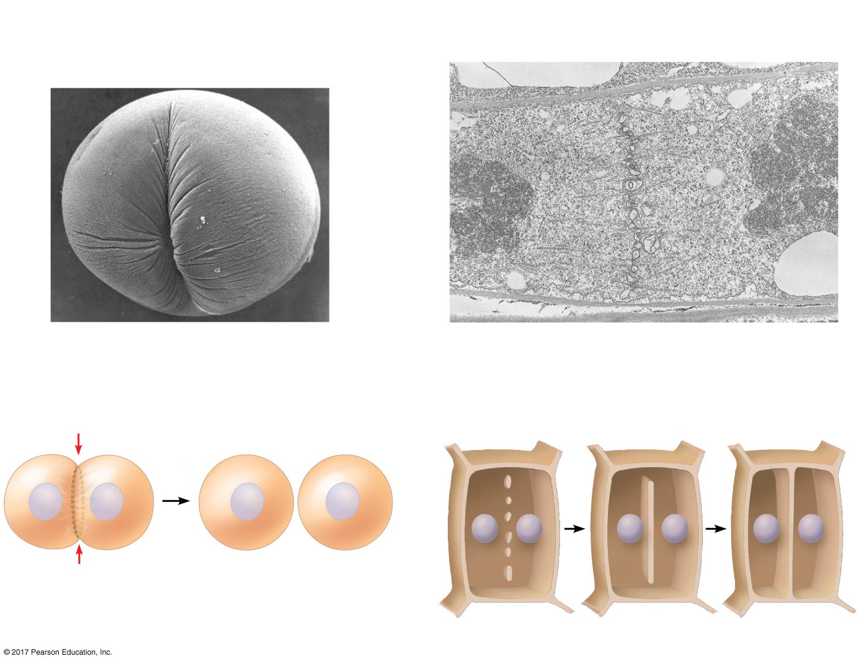
Figure 12.10
(a) Cleavage of an animal cell (SEM)
(b) Cell plate formation in a plant cell (TEM)
Cleavage furrow
100 µm
Vesicles
forming
cell plate
Wall of parent cell
1 µm
New cell
wall
Cell plate
Contractile ring of
microfilaments
Daughter cells
Daughter cells
Notes:
Figure 12.10 Cytokinesis in animal and plant cells

Slide 33
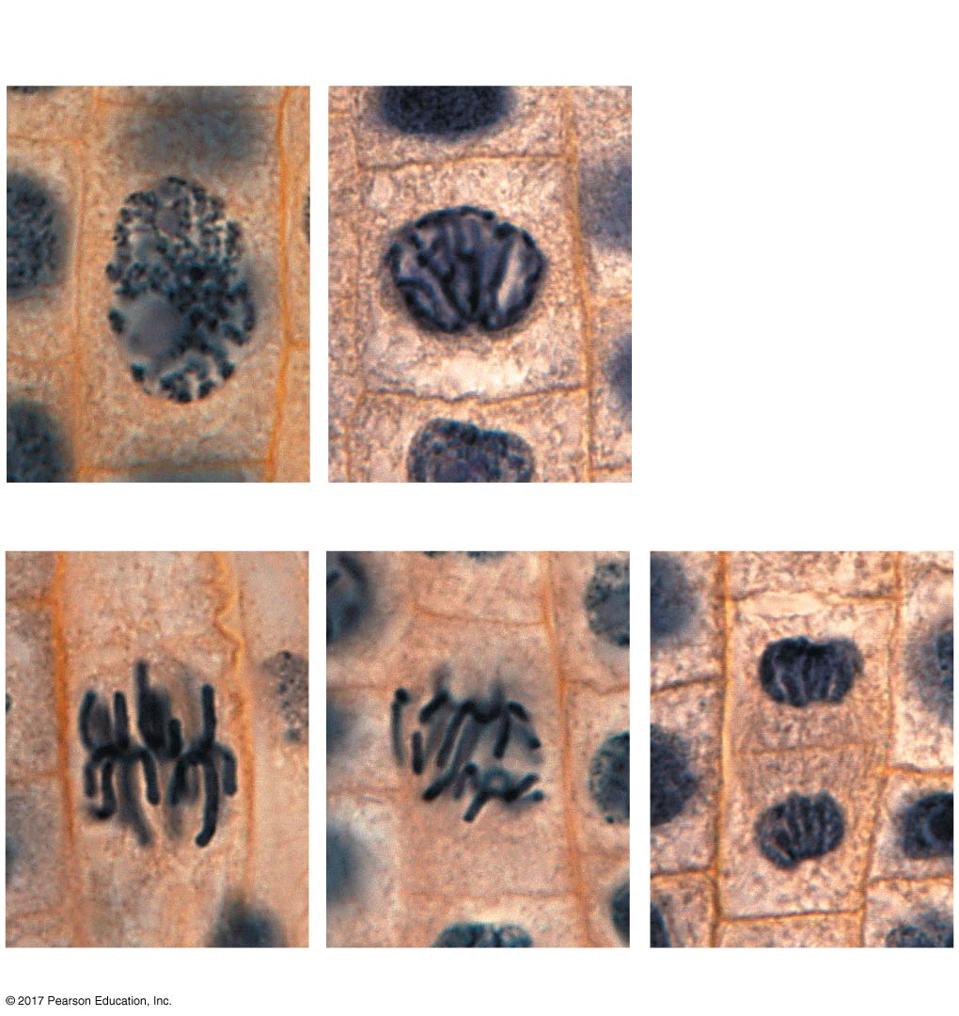
Figure 12.11
Nucleus
Chromosomes
condensing
Nucleolus
Chromosomes
Mitosis in a plant cell
10 µm
1
Prophase
2
Prometaphase
Cell plate
3
Metaphase
4
Anaphase
5
Telophase
Notes:
Figure 12.11 Mitosis in a plant cell

Slide 34
Binary Fission (二分裂) in Bacteria
Prokaryotes (bacteria and archaea) reproduce by a type of cell division called binary fission
In binary fission, the chromosome replicates (beginning at the origin of replication), and the two daughter chromosomes actively move apart
The plasma membrane pinches inward, dividing the cell into two

Slide 35
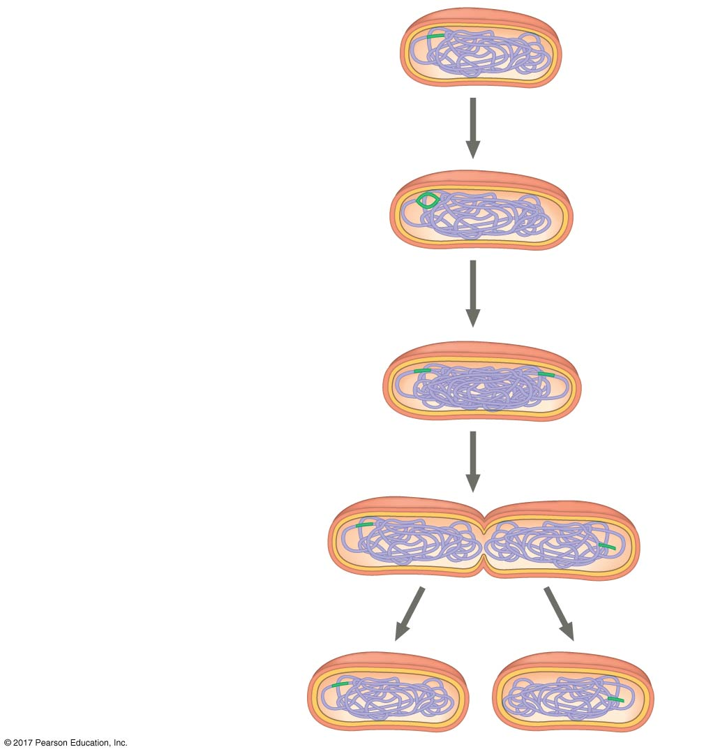
Figure 12.12_4
Bacterial cell division by binary fission
Origin of
replication
Cell wall
Plasma
membrane
Bacterial cell
Bacterial
chromosome
1
Chromosome
replication
begins.
Two copies
of origin
Origin
Origin
2
One copy of the
origin is now at
each end of the
cell.
3
Replication
finishes.
4
Two daughter
cells result.
Notes:
Figure 12.12_4 Bacterial cell division by binary fission (step 4)

Slide 36
The Evolution of Mitosis
Because prokaryotes evolved before eukaryotes, mitosis probably evolved from binary fission
Certain protists(原生生物)exhibit types of cell division that seem intermediate between binary fission and mitosis

Slide 37
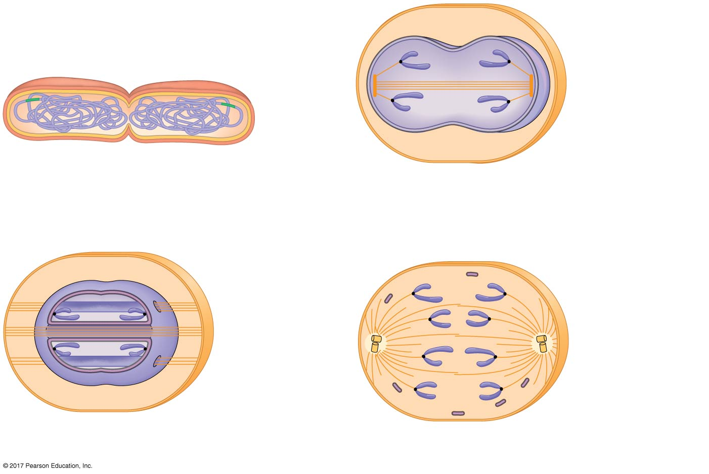
Figure 12.13
Mechanisms of cell division in several groups of organisms
Bacterial
chromosome
Kinetochore
microtubule
Intact nuclear
envelope
(a) Bacteria
(c) Diatoms and some yeasts
Chromosomes
Kinetochore
microtubule
Microtubules
Intact nuclear
envelope
Fragments of
nuclear
envelope
(b) Dinoflagellates
(d) Most eukaryotes
Notes:
Figure 12.13 Mechanisms of cell division in several groups of organisms

Slide 38
Concept 12.3: The eukaryotic cell cycle is regulated by a molecular control system
The frequency of cell division varies with the type of cell
These differences result from regulation at the molecular level
Cancer cells manage to escape the usual controls on the cell cycle

Slide 39
The Cell Cycle Control System
The cell cycle appears to be driven by specific chemical signals present in the cytoplasm
Some evidence for this hypothesis comes from experiments in which cultured mammalian cells at different phases of the cell cycle were fused to form a single cell with two nuclei

Slide 40
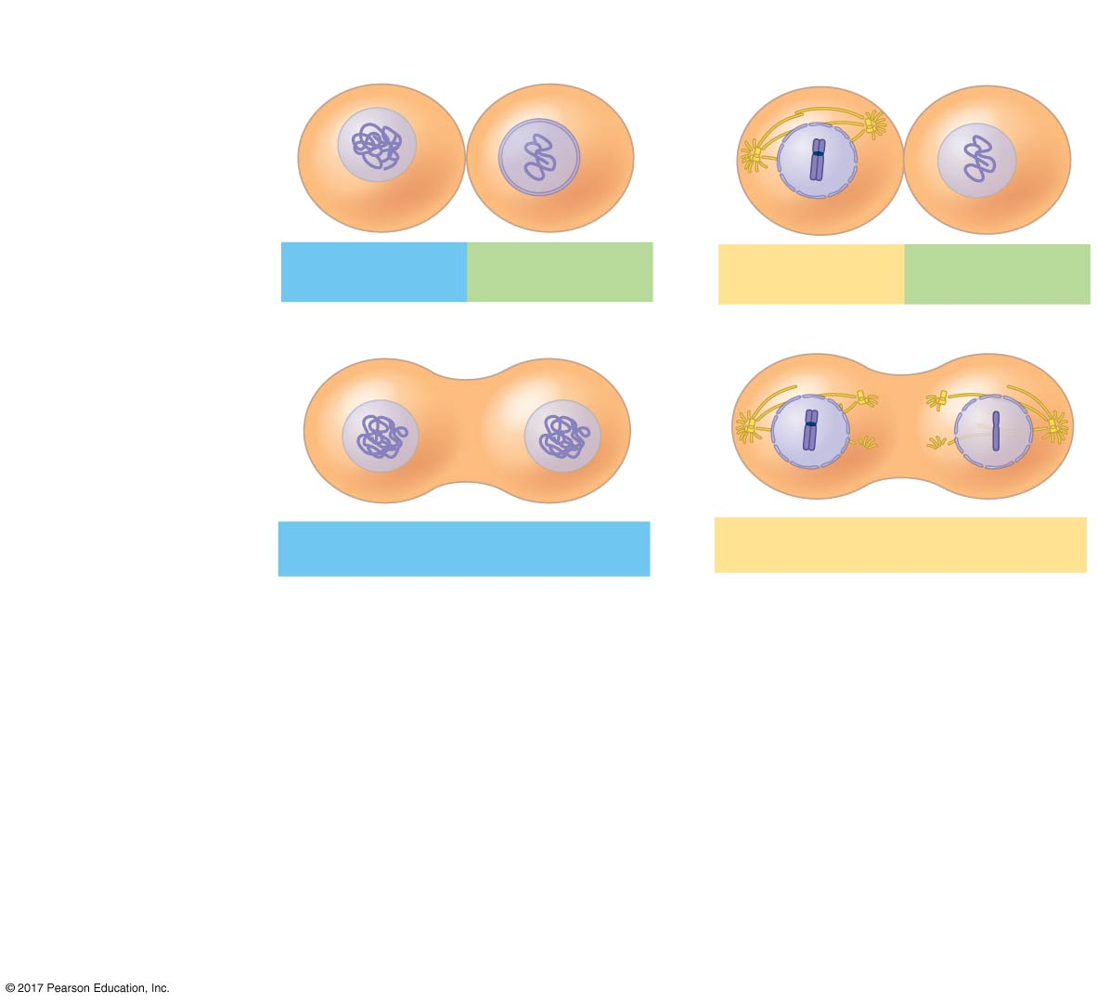
Figure 12.14
Experiment
Experiment 1
Experiment 2
Molecular signals in the cytoplasm regulate the cell cycle
S
G₁
M
G₁
Results
S
S
M
M
G₁ nucleus
immediately entered
S phase and DNA
was synthesized.
G₁ nucleus began
mitosis without
chromosome
duplication.
Conclusion
Molecules present in the cytoplasm control
the progression to S and M phases.
Data from R. T. Johnson and P. N. Rao, Mammalian cell fusion: Induction of premature
chromosome condensation in interphase nuclei, Nature 226:717–722 (1970).
Notes:
Figure 12.14 Inquiry: Do molecular signals in the cytoplasm regulate the cell cycle?

Slide 41
The sequential events of the cell cycle are directed by a distinct cell cycle control system, which is similar to a clock
The cell cycle control system is regulated by both internal and external controls
The clock has specific checkpoints where the cell cycle stops until a go-ahead signal is received

Slide 42
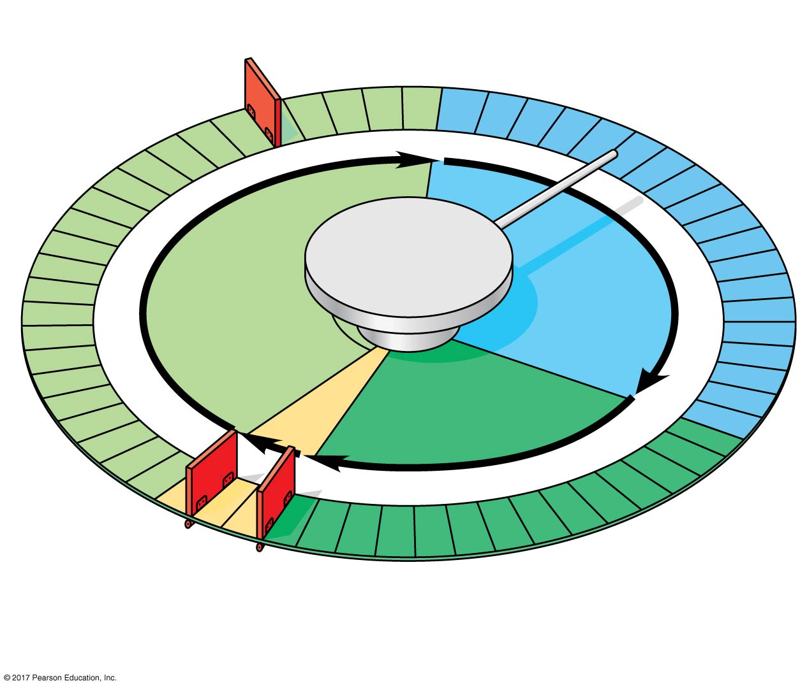
Figure 12.15
Mechanical analogy for the cell cycle control system
G₁ checkpoint
Control
system
G₁
S
M
G₂
M checkpoint
G₂ checkpoint
Notes:
Figure 12.15 Mechanical analogy for the cell cycle control system

Slide 43
The Cell Cycle Clock: Cyclins and Cyclin-Dependent Kinases (激酶)
Two types of regulatory proteins are involved in cell cycle control: cyclins週期素and cyclin-dependent kinases (Cdks週期素激酶)
The activity of a Cdk rises and falls with changes in concentration of its cyclin partner
MPF (maturation-promoting factor) is a cyclin-Cdk complex that triggers a cell’s passage past the G₂ checkpoint into the M phase

Slide 44
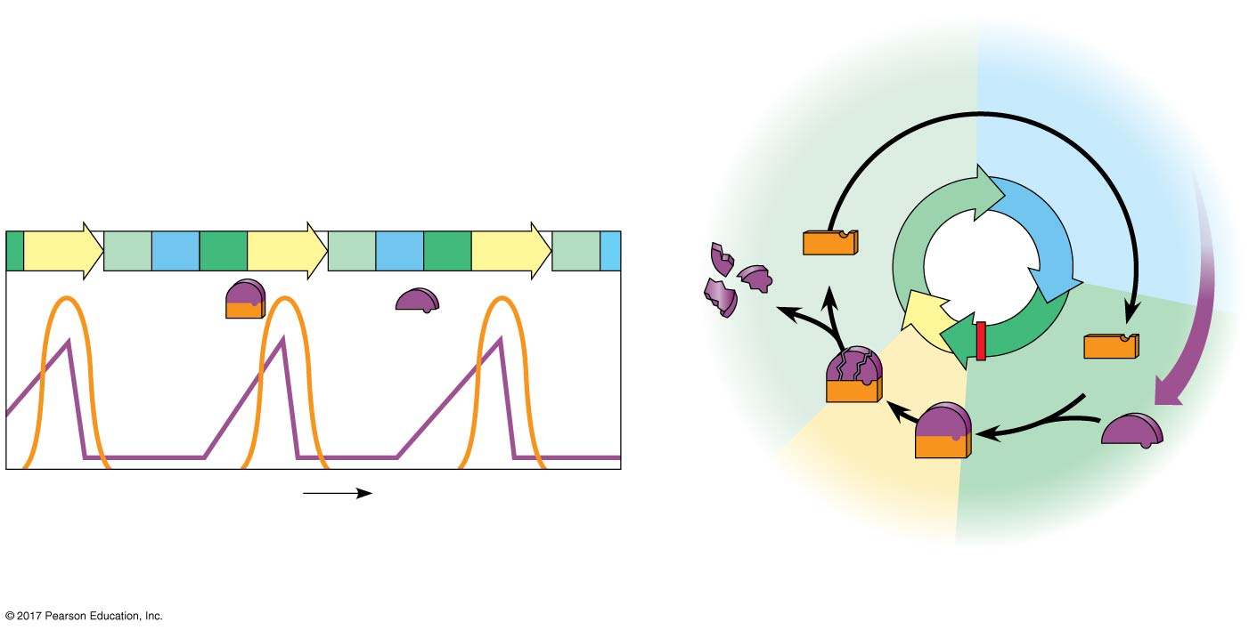

Figure 12.16
Molecular control of the cell cycle at the G₂ checkpoint
G₁
S
M
G₁
S
G₂
M
G₁
S
G₂
M
G₁
Cdk
MPF
activity
Cyclin
concentration
Degraded
cyclin
M
G₂
Cdk
Cyclin is
degraded
MPF
Cyclin
Time
G₂
checkpoint
(a) Fluctuation of MPF activity and cyclin concentration during the cell cycle
(b) Molecular mechanisms that help regulate the cell cycle
Notes:
Figure 12.16 Molecular control of the cell cycle at the G₂ checkpoint

Slide 45
Stop and Go Signs: Internal and External Signals at the Checkpoints
Many signals registered at checkpoints come from cellular surveillance mechanisms within the cell
Checkpoints also register signals from outside the cell
Three important checkpoints are those in the G₁, G₂, and M phases

Slide 46
For many cells, the G₁ checkpoint seems to be the most important
If a cell receives a go-ahead signal at the G₁ checkpoint, it will usually complete the S, G₂, and M phases and divide
If the cell does not receive the go-ahead signal, it will exit the cycle, switching into a nondividing state called the G₀ phase

Slide 47
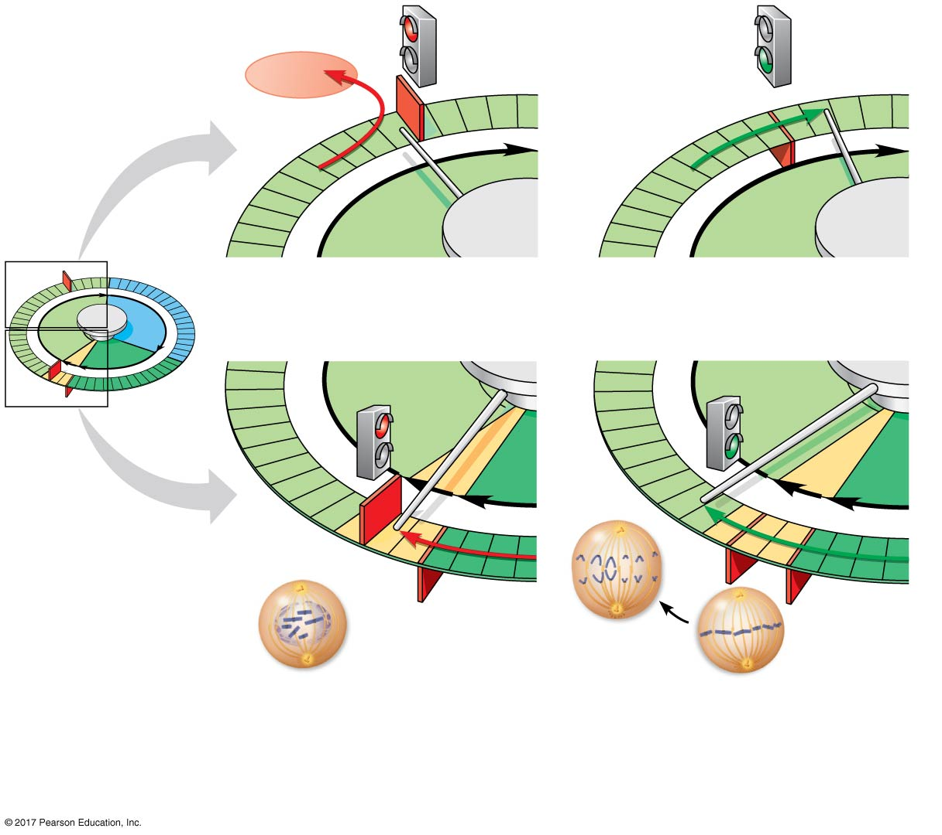
Figure 12.17
Two important checkpoints
G₁ checkpoint
G₀
G₁
G₁
Without go-ahead signal, cell
enters G₀.
With go-ahead signal, cell
continues cell cycle.
G₁
S
G₂
(a) G₁ checkpoint
M
G₁
G₁
M
G₂
M
G₂
M checkpoint
Anaphase
G₂
checkpoint
Prometaphase
Metaphase
Without full chromosome attachment,
stop signal is received.
With full chromosome
attachment, go-ahead signal is
received.
(b) M checkpoint
Notes:
Figure 12.17 Two important checkpoints

Slide 48
An example of an internal signal is that cells will not begin anaphase until all chromosomes are properly attached to the spindle at the metaphase plate
This mechanism ensures that daughter cells have the correct number of chromosomes

Slide 49
External factors that influence cell division include specific growth factors
Growth factors are released by certain cells and stimulate other cells to divide
Platelet-derived growth factor (PDGF) is made by blood cell fragments called platelets
In density-dependent inhibition, crowded cells will stop dividing

Slide 50
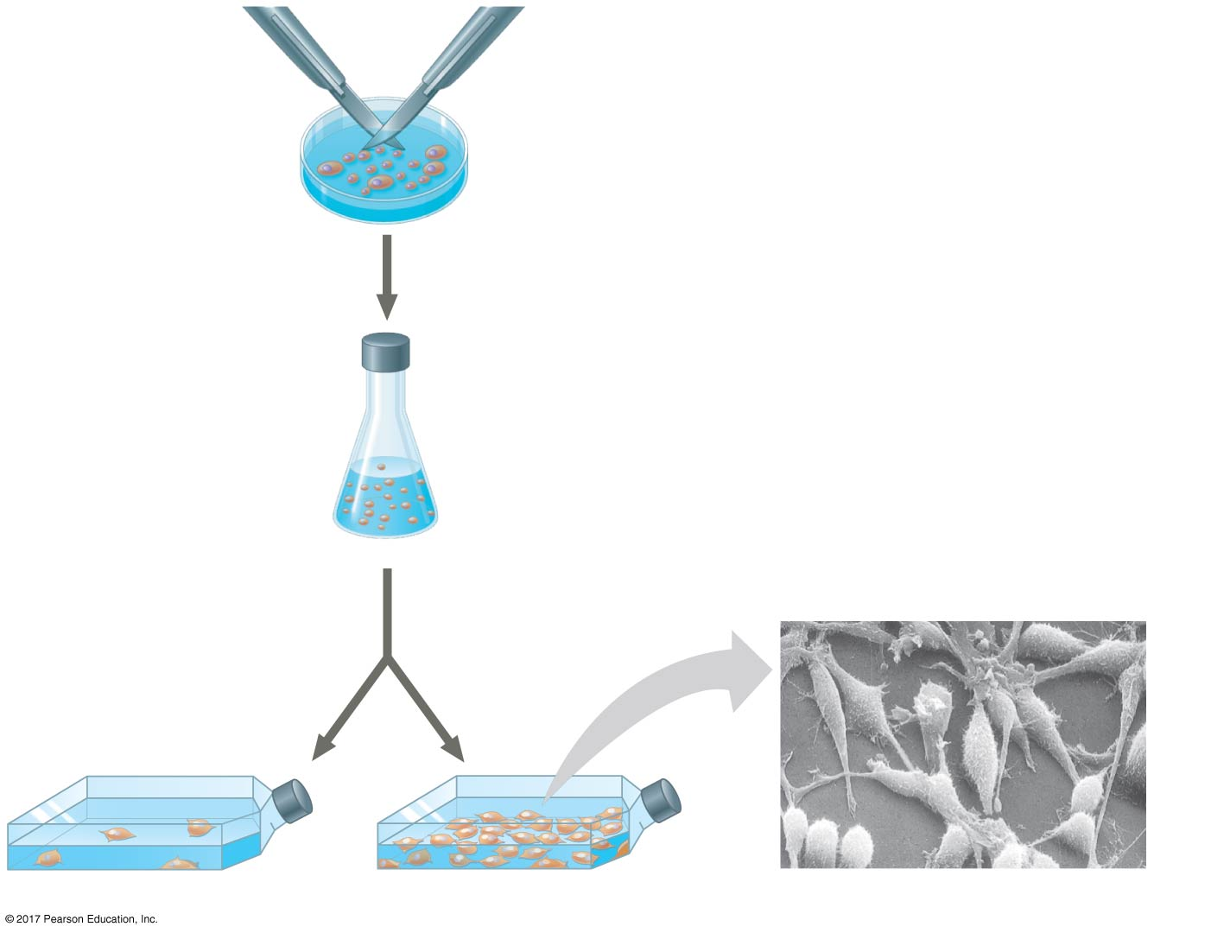
Figure 12.18_4
Scalpels
1
A sample of
human connective
tissue is cut
up into small
pieces.
The effect of platelet-derived growth factor (PDGF) on cell division
Petri
dish
2
Enzymes digest
the extracellular
matrix, resulting
in a suspension of
free fibroblasts.
3
Cells are transferred
to culture vessels.
4
PDGF is added
to half the
vessels.
10 µm
Without PDGF
With PDGF
Cultured fibroblasts (SEM)
Notes:
Figure 12.18_4 The effect of platelet-derived growth factor (PDGF) on cell division (step 4)

Slide 51
Most cells also exhibit anchorage dependence (固著依賴性) —to divide, they must be attached to a substratum培養真核細胞時,需要使其附著於某些物質,始能在培養基上生長分裂的性質
Density-dependent inhibition密度制約抑制 and anchorage dependence check the growth of cells at an optimal density
Cancer cells exhibit neither type of regulation of their division

Slide 52
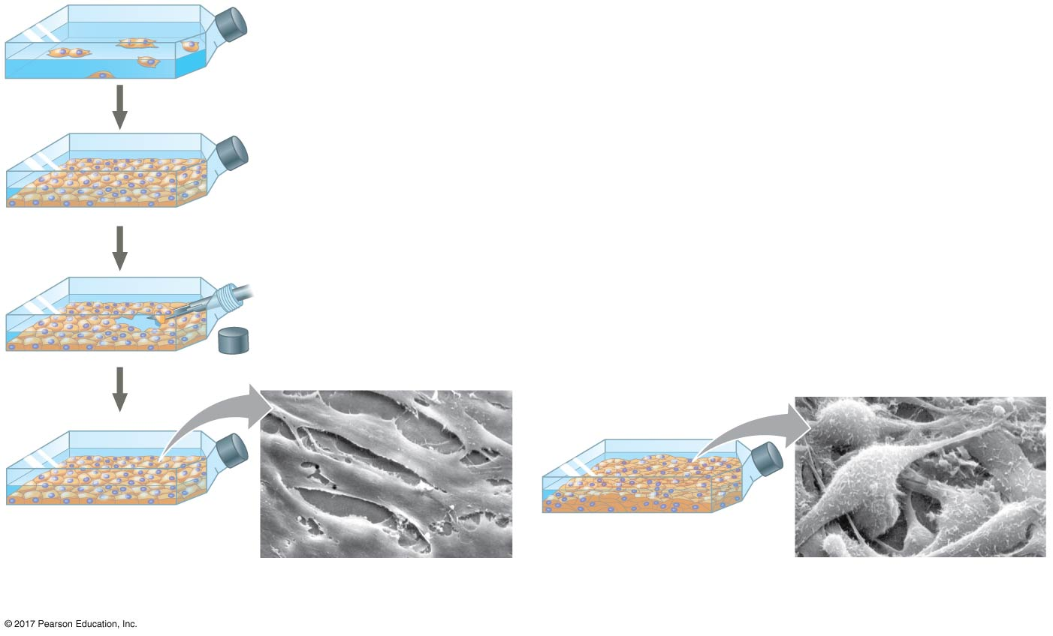
Figure 12.19
Density-dependent inhibition and anchorage dependence of cell division
Anchorage dependence: cells
require a surface for division
Density-dependent inhibition:
cells form a single layer
Density-dependent inhibition:
cells divide to fill a gap and
then stop
20 µm
20 µm
(a) Normal mammalian cells
(b) Cancer cells
Notes:
Figure 12.19 Density-dependent inhibition and anchorage dependence of cell division

Slide 53
Loss of Cell Cycle Controls in Cancer Cells
Cancer cells do not respond normally to the body’s control mechanisms
Cancer cells do not need growth factors to grow and divide:
They may make their own growth factor
They may convey a growth factor’s signal without the presence of the growth factor
They may have an abnormal cell cycle control system

Slide 54
Cells that acquire the ability to divide indefinitely are undergoing transformation
Cancer cells that are not eliminated by the immune system form tumors, masses of abnormal cells within otherwise normal tissue
If abnormal cells remain only at the original site, the lump is called a benign tumor(良性腫瘤)

Slide 55
Malignant tumors (惡性腫瘤)invade surrounding tissues and can undergo metastasis (遠端轉移), the spread of cancer cells to other parts of the body, where they may form additional tumors
Localized tumors may be treated with high-energy radiation, which damages the DNA in the cancer cells
To treat metastatic cancers, chemotherapies that target the cell cycle may be used

Slide 56
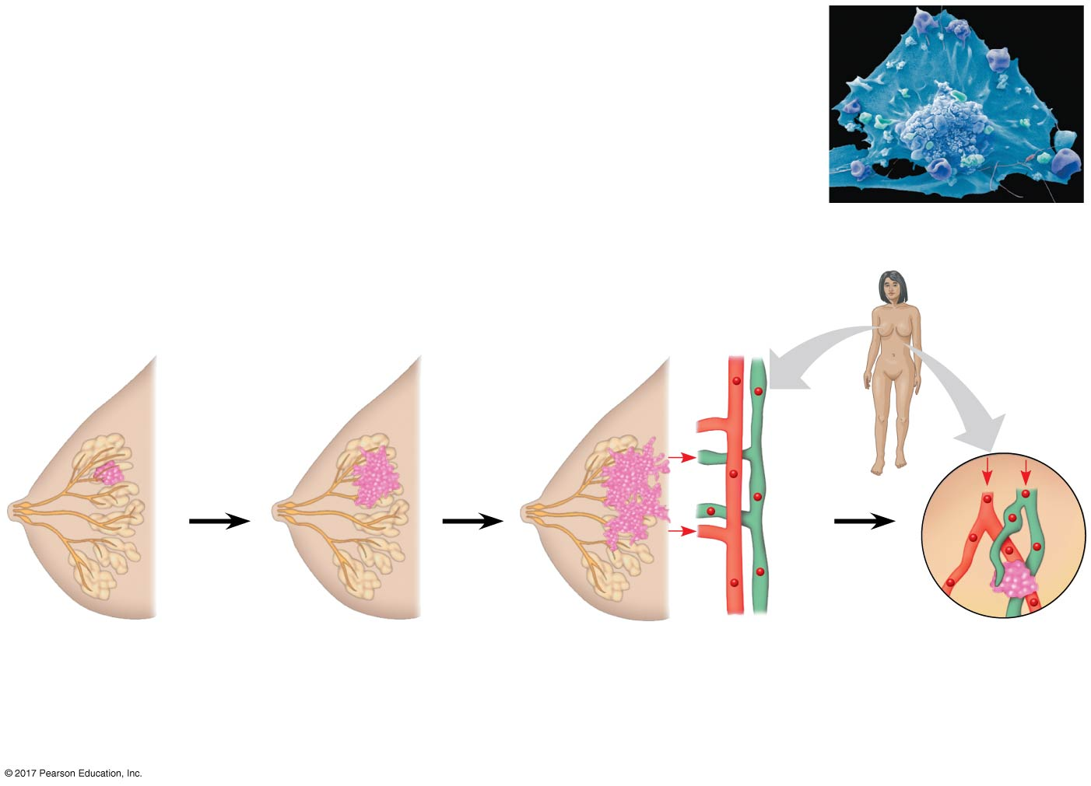
Figure 12.20
The growth and metastasis of a malignant breast tumor
5 µm
Breast cancer cell
(colorized SEM)
Metastatic
tumor
Lymph
vessel
Tumor
Blood
vessel
Glandular
tissue
Cancer
cell
1
A tumor grows
from a single
cancer cell.
2
Cancer cells invade
neighboring tissue.
3
Cancer cells spread
through lymph and
blood vessels to other
parts of the body.
4
A small percentage
of cancer cells may
metastasize to
another part of the
body.
Notes:
Figure 12.20 The growth and metastasis of a malignant breast tumor

Slide 57
Recent advances in understanding the cell cycle and cell cycle signaling have led to advances in cancer treatment
Coupled with the ability to sequence the DNA of cells in a particular tumor, treatments are becoming more “personalized”

